Slide 1
Hacker101 CTF
Micro-CMS v1

Slide 2
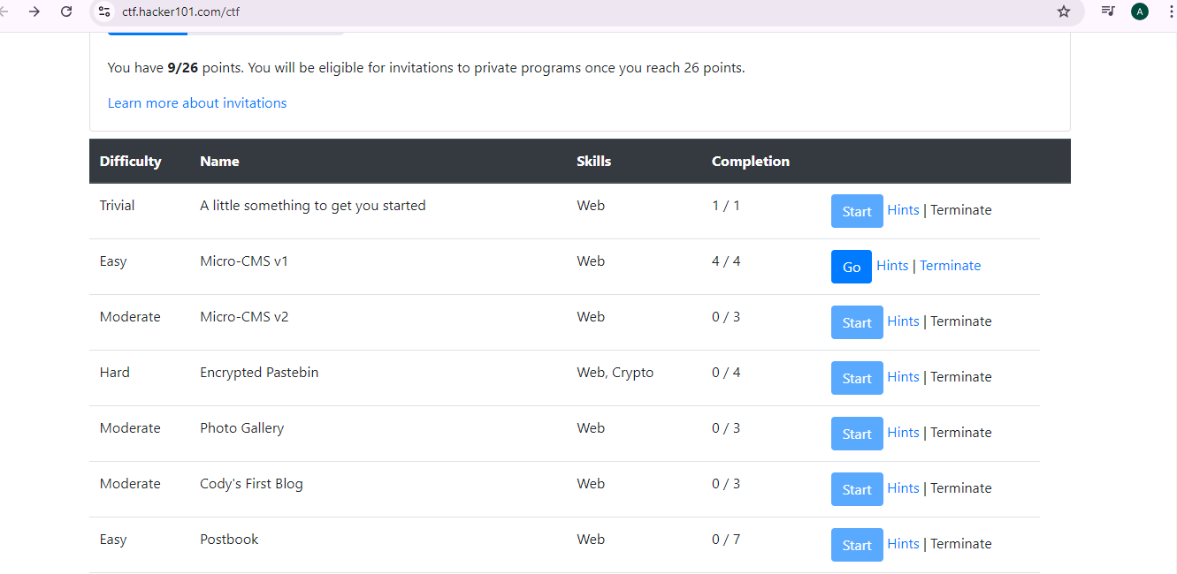
Next challenge is Micro-CMS v1

Slide 3
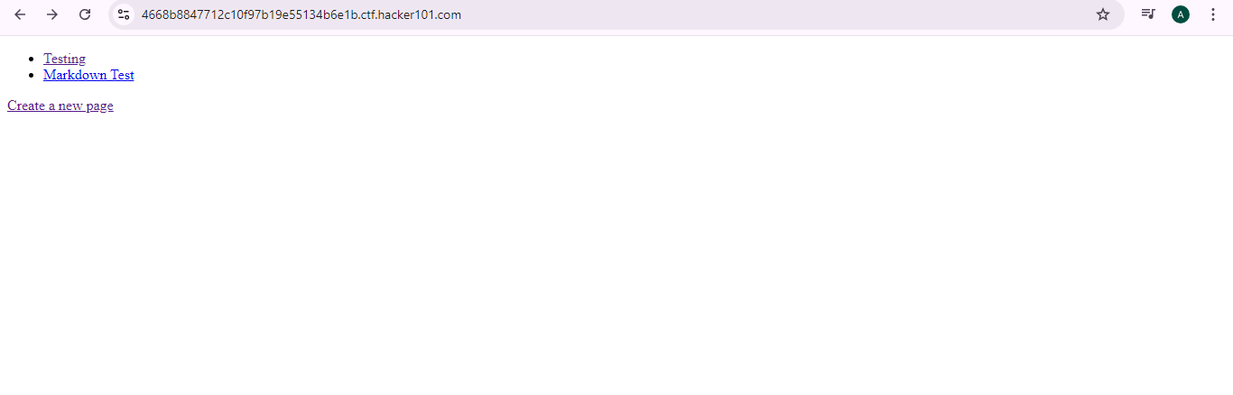
In the first page you will see Testing, Markdown Test, create a new page, lets have a look and start click on Testing

Slide 4
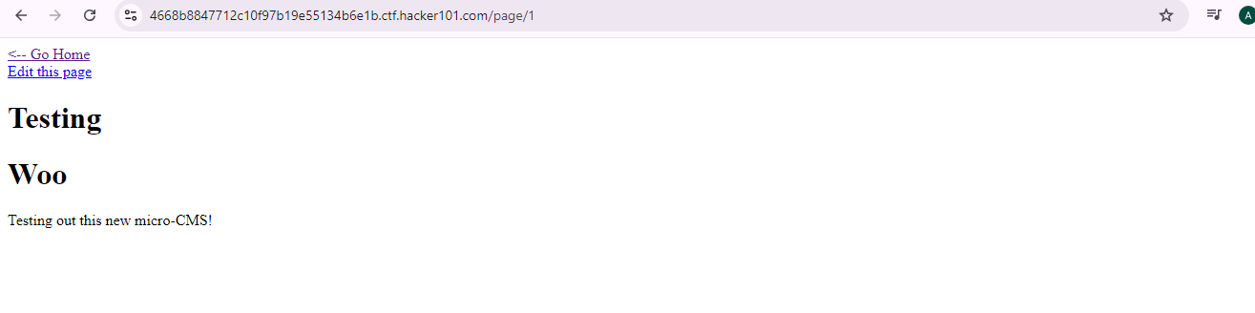
Notice Testing is already page 1 as you see in the address, click Go home

Slide 5
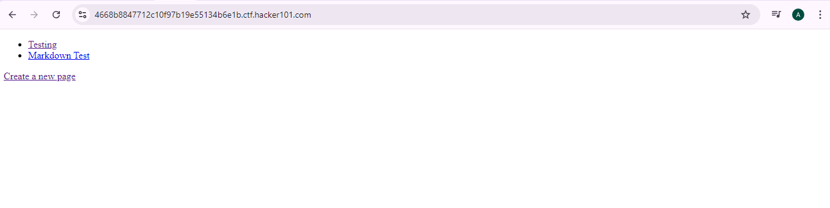
Click on Markdown Test

Slide 6
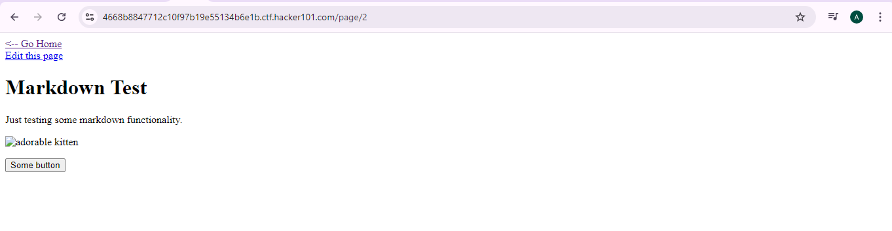
Click on some button and check if there anyting, Notice Markdown Test is already page 2 as you see in the address, then Click go Home

Slide 7
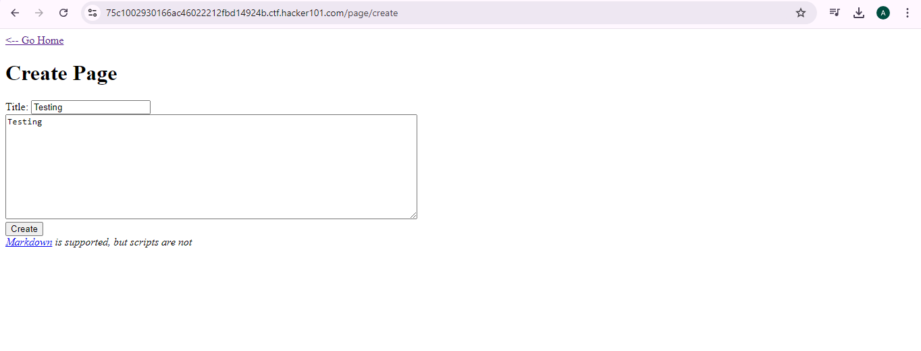
Next step click on Create a new page and write in the title a name as example write testing nad click create

Slide 8
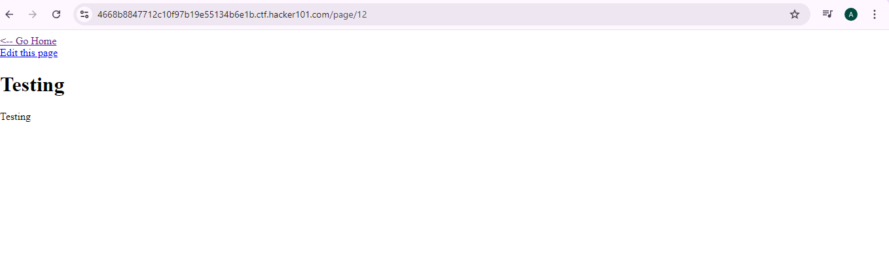
Notice that after creating the page its Number 12, it might with you can be a different number

Slide 9
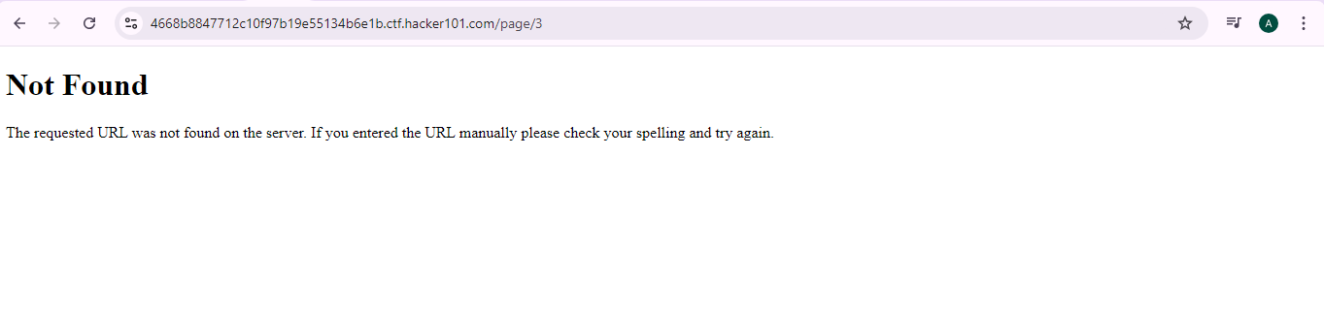
To find the flag you have to check hints each time, next step is to change page number in the address you can add ,3,4,5,6,7,8,9........ until you see the flag

Slide 10
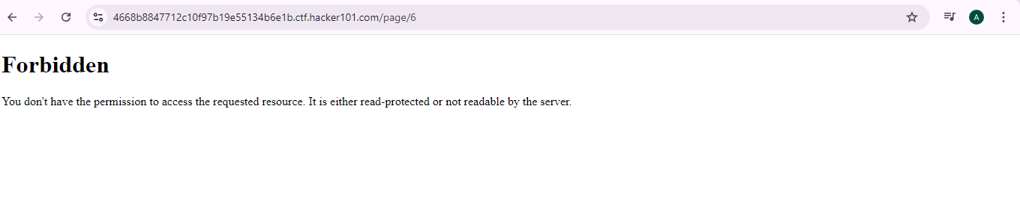
We found page number 6 is Forbidden so lets go back to the Testing page

Slide 11
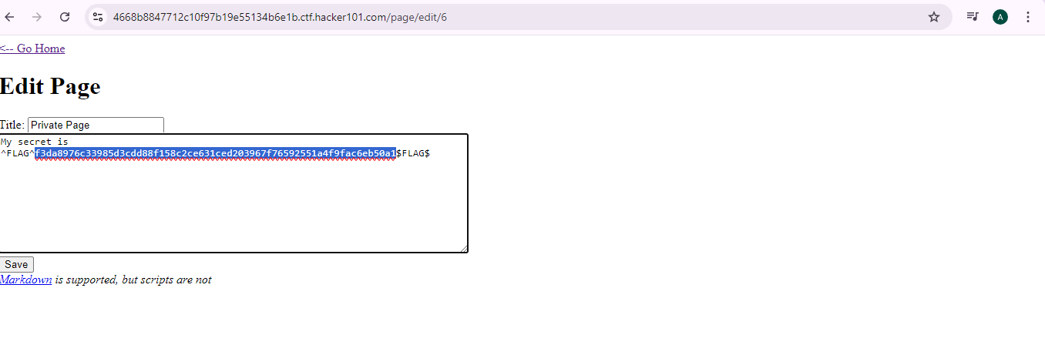
Click edit page and add number 6 in the address and then click enter , It will show you her secret it the flag copy the flag and go to the main page

Slide 12
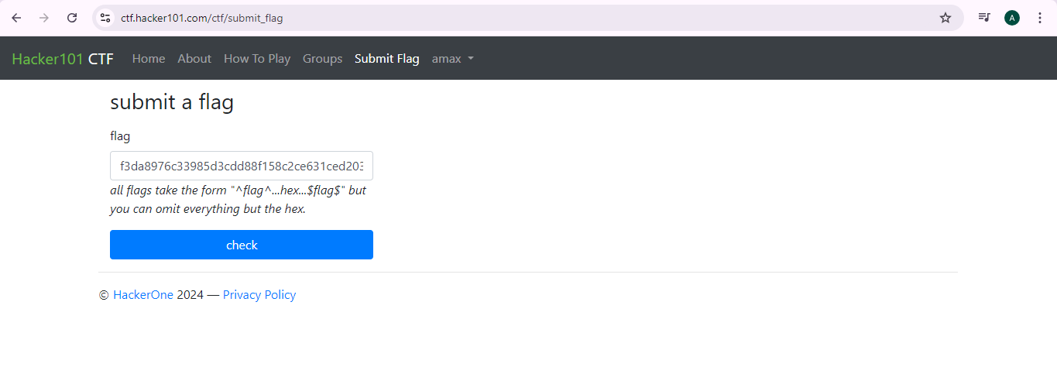
Submit the flag and copy iot and then click check

Slide 13
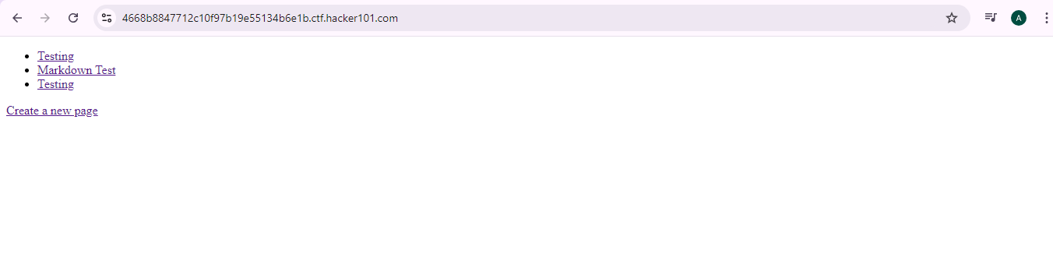
Click create a new page

Slide 14
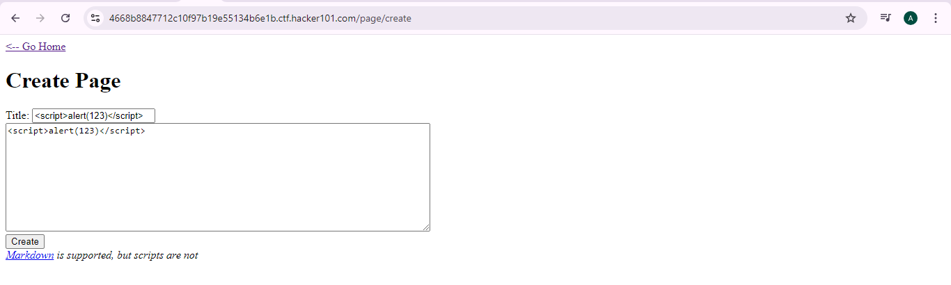
A the code in the Tittle and then click create and then click go home

Slide 15
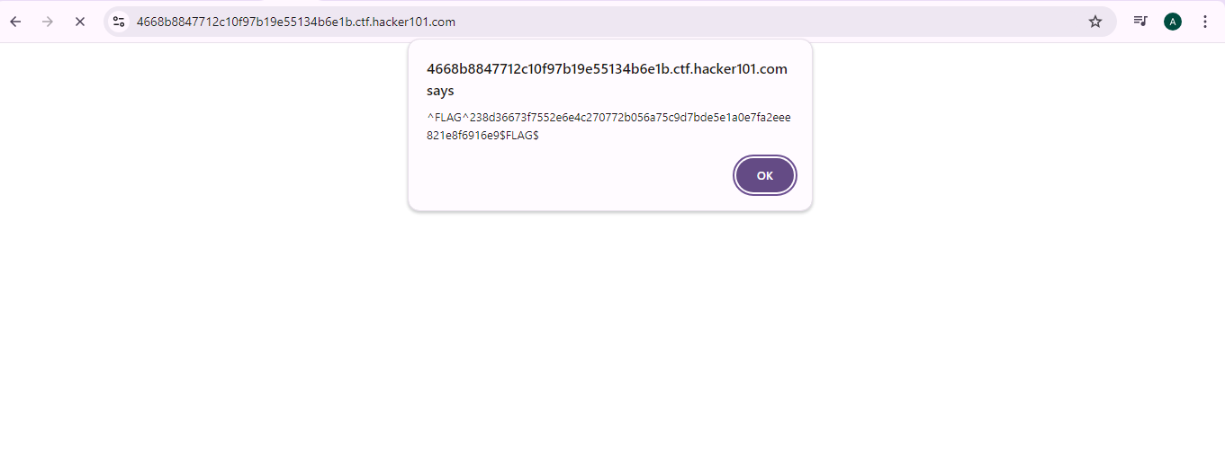
here you will get a flag lets copy it and paste it in submit a flag

Slide 16

after you paste the code click check .

